Slide 1
Crafting Compelling Web Presences (MBT8)
By
Gokulakrishnan R

Slide 2
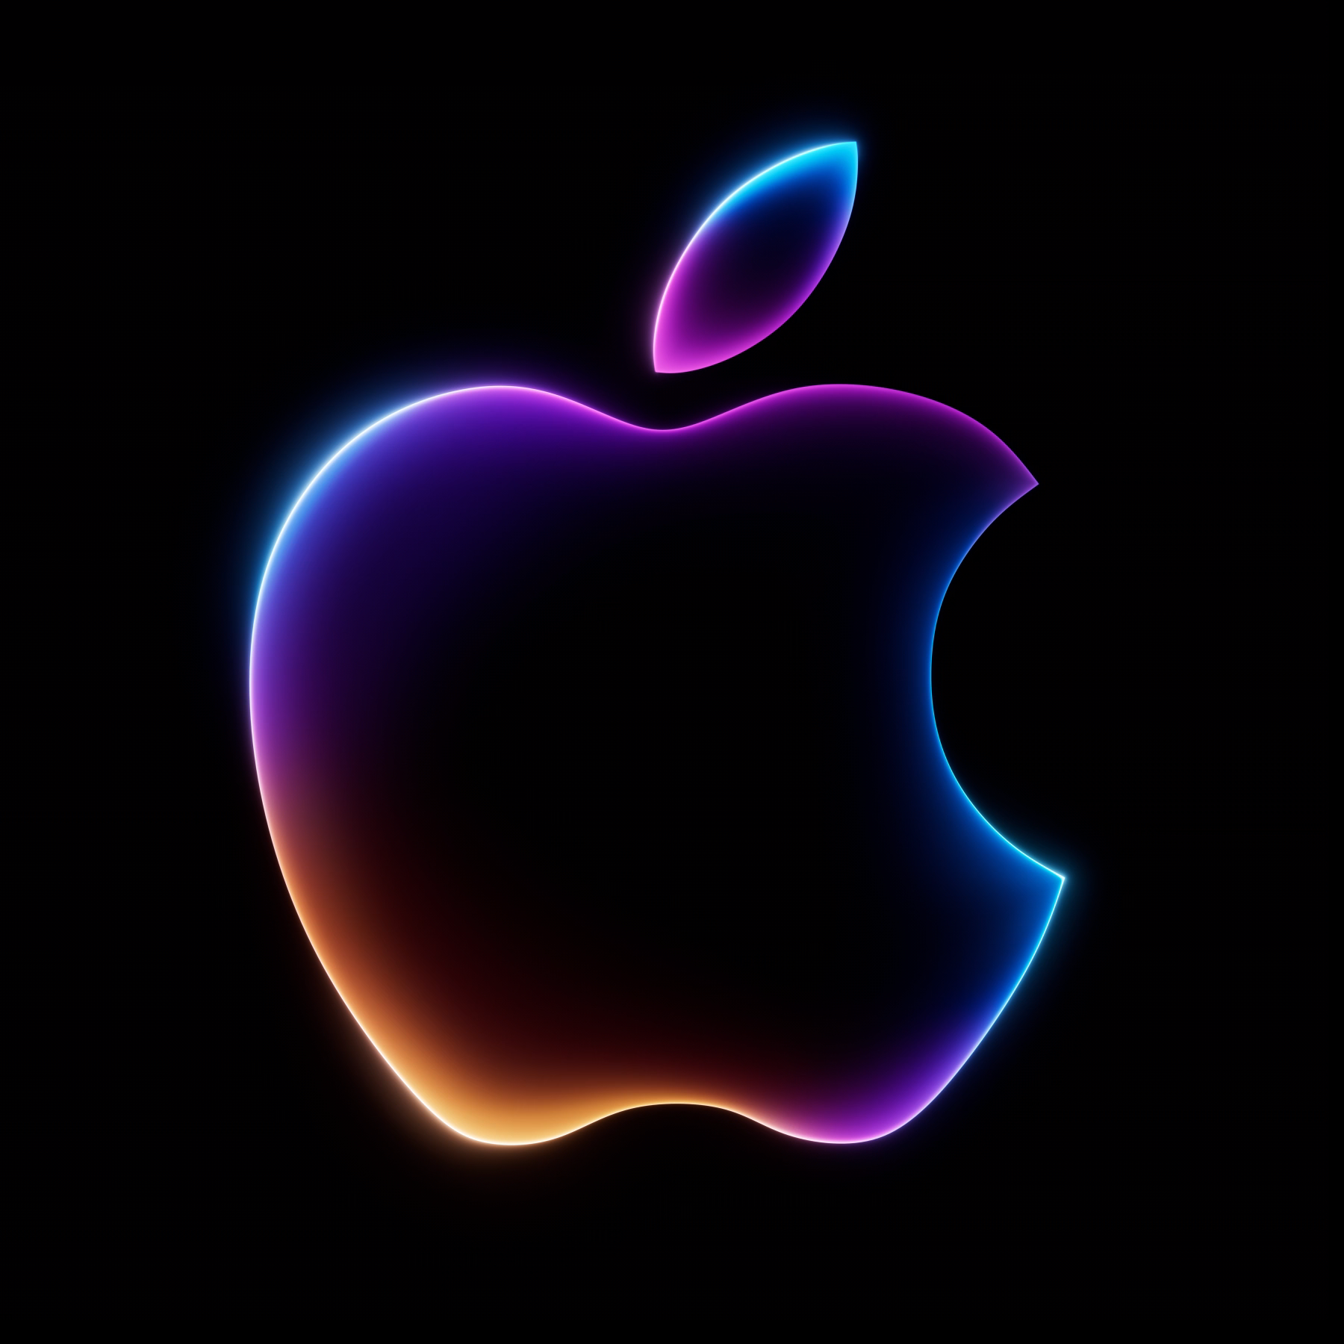
Apple

Slide 3
Products We are going to cover
IPHONE 16 Pro
IWATCH SERIES 10
AIRPODS MAX

Slide 4
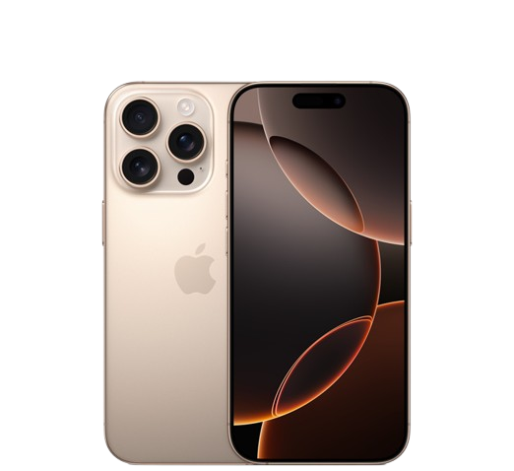
Description
Super Retina XDR display iPhone 16 Pro: 6.3-inch OLED with adaptive refresh rates up to 120Hz.
Performance A18 Pro chip 6-core CPU (2 performance, 4 efficiency cores) 6-core GPU.16-core Neural Engine.
Camera System Pro camera setup48MP Fusion main camera with optical image stabilization.2x Telephoto lens (48MP).Ultra Wide lens (48MP).
Apple Intelligence Personal intelligence system with privacy protections .Helps with writing, expression, and productivity.

Slide 5
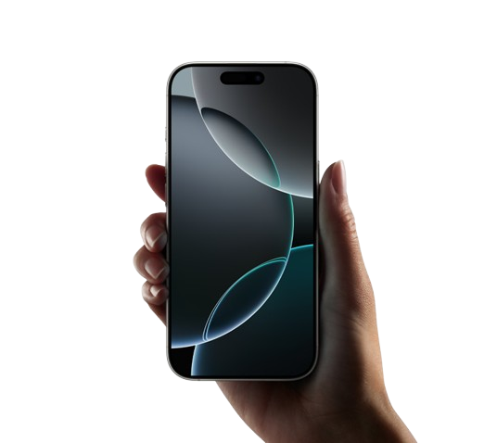
UNiqueness
The iPhone 16 Pro includes advancements in emergency communication and health monitoring
Located on the bottom right side of the phone, it operates similarly to a DSLR shutter button.
Soft presses focus on the subject, while harder presses capture the photo.
Siri, Apple’s voice assistant, gets a much-needed makeover.

Slide 6
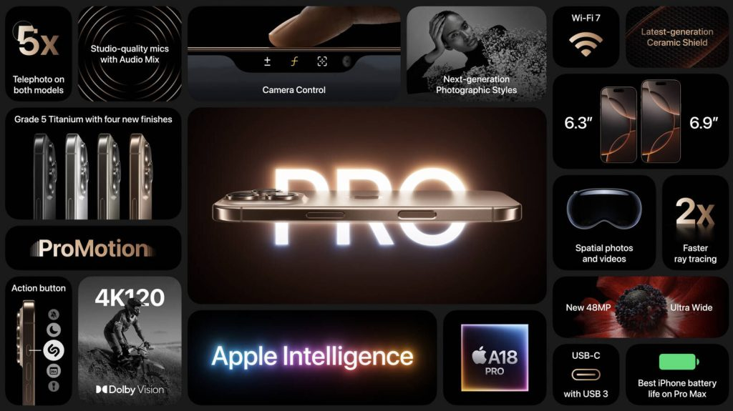
Product highlights

Slide 7
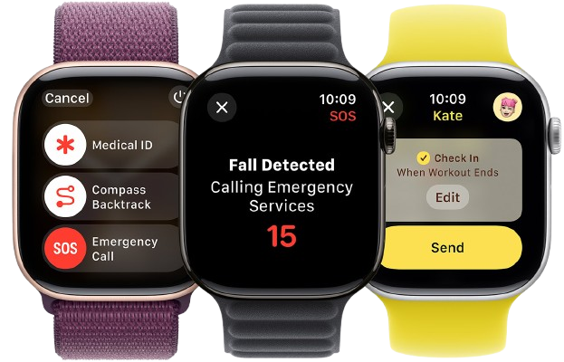
Descriptions
The thinnest Apple Watch yet, making it more comfortable than ever.
Always-On display with ProMotion technology.
Water depth and temperature sensing.
Safety features like Crash Detection and Fall Detection

Slide 8
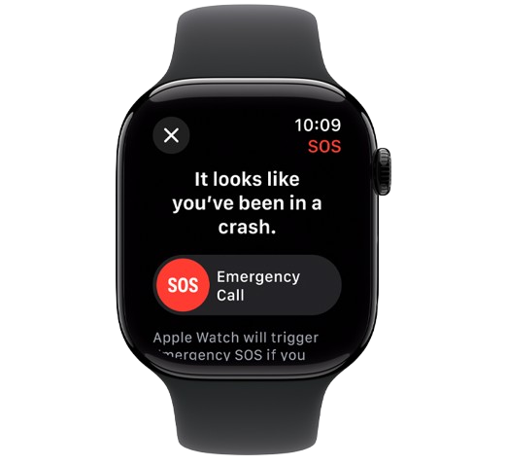
UNiqueness
Battery Life: Still an impressive 18 hours per charge.
Intelligence and Fitness Insights: Safety features like Crash Detection and Fall Detection.
Innovative Technology: New sleep apnea notifications.
Faster charging: Capabilities. Water depth and temperature sensing.

Slide 9
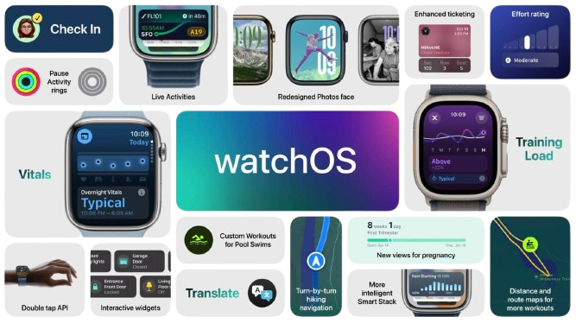
Product highlights

Slide 10
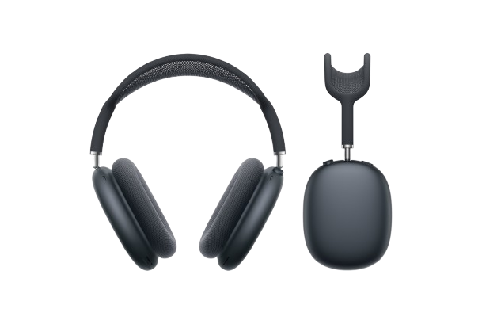
Descriptions
Apple-designed dynamic driver.Pro-level Active Noise Cancellation (ANC).
Transparency mode for awareness of surroundings.
Dimensions (including cushions): 6.64 inches (168.6 mm) x 3.28 inches (83.4 mm) x 7.37 inches (187.3 mm).
Weight: 13.6 ounces (386.2 grams).
Bluetooth 5.0 wireless technology.
Compatible with iPhone, iPad, Apple Watch, Mac, and Apple TV.

Slide 11
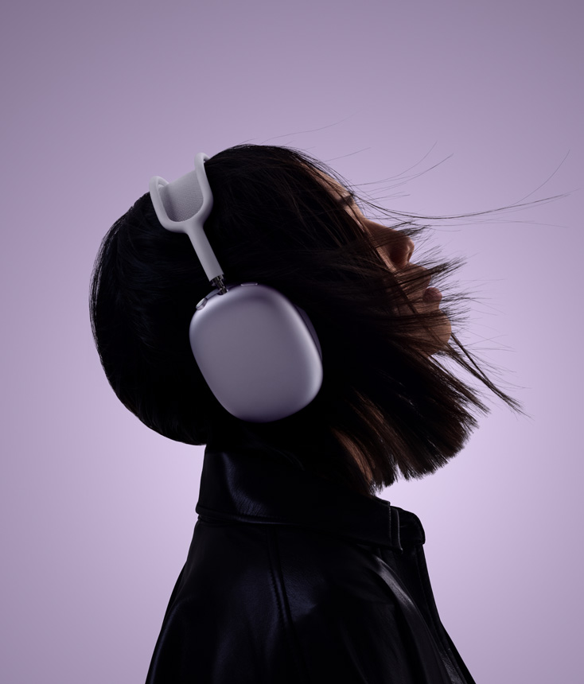
UNiqueness
High-Fidelity Audio: Custom-built drivers deliver stunningly detailed sound with ultra-low distortion across the audible range.
Pro-Level Active Noise Cancellation (ANC): Up to 2x more noise cancellation compared to other headphones
Transparency Mode: Switch to Transparency mode to let outside sound in naturally.
Elegant Design and Comfort: Soft-coated headband with a breathable knit mesh canopy.
Apple Ecosystem Integration: Seamlessly switch between iOS devices.

Slide 12
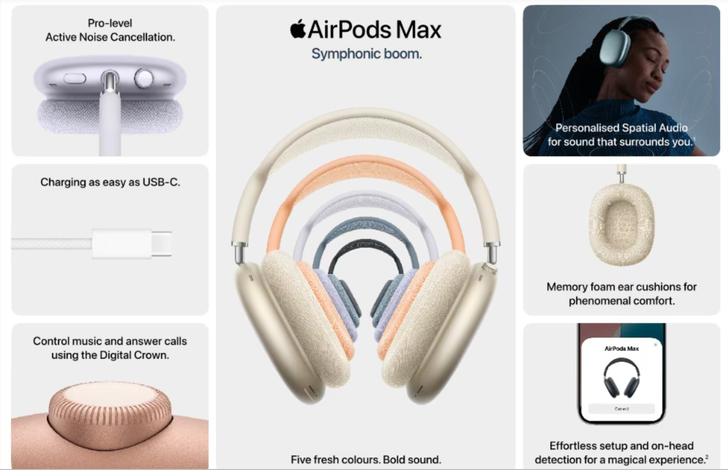
Product highlights

Slide 13
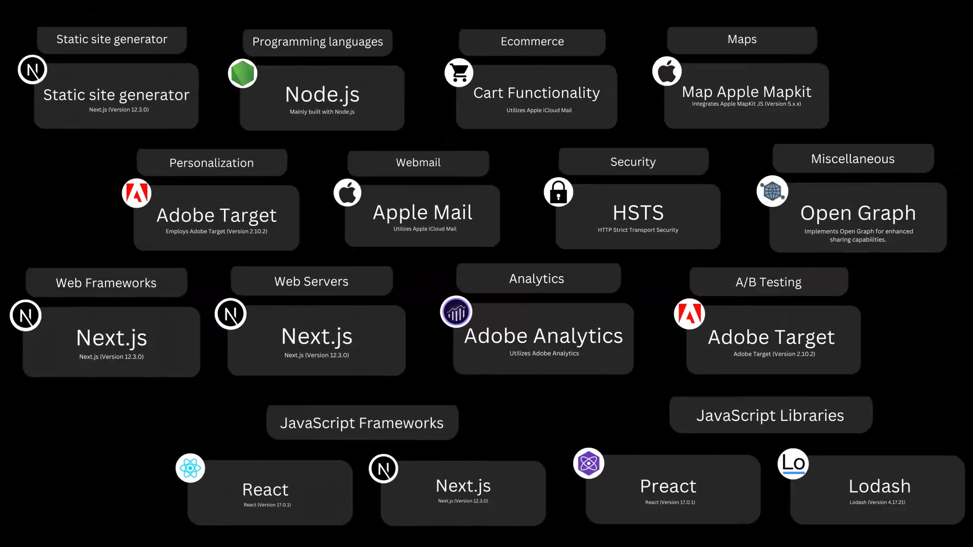
platform’s development tools

Slide 14
Desktop
Tab
Phone
Laptop

Slide 15
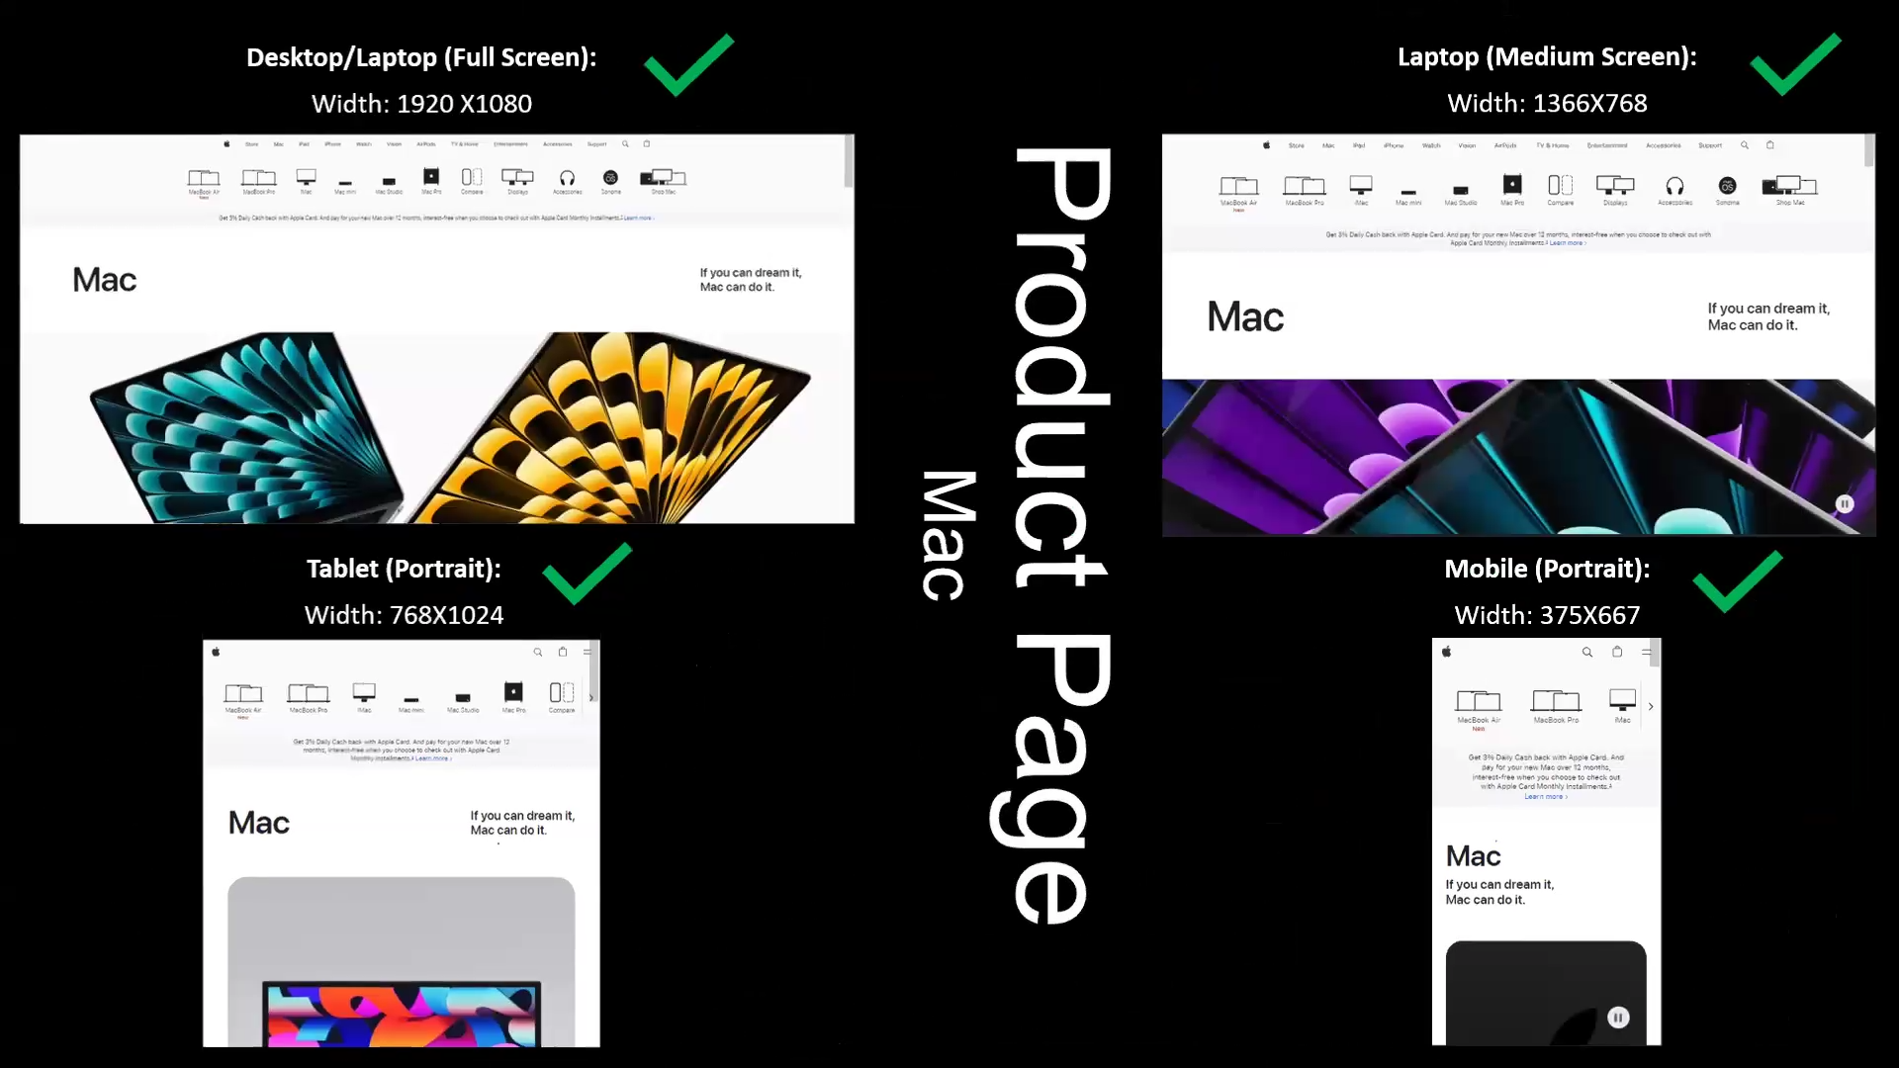
Product Page

Slide 16
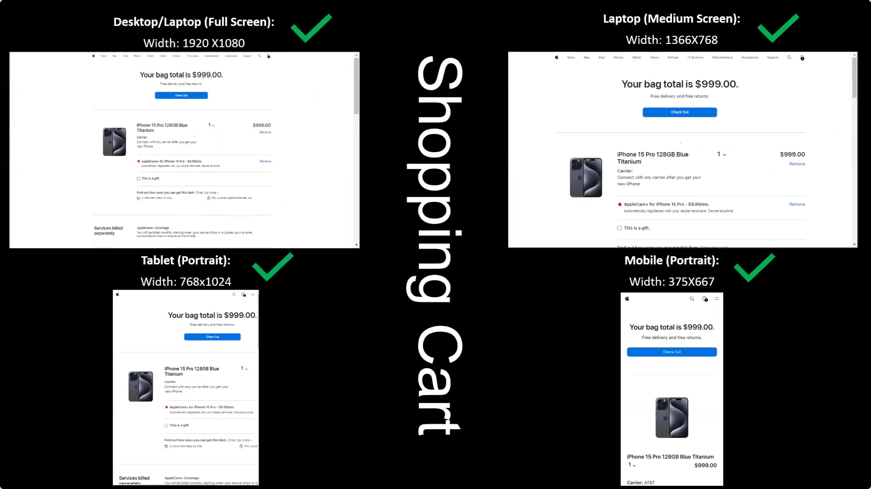
Shopping cart

Slide 17
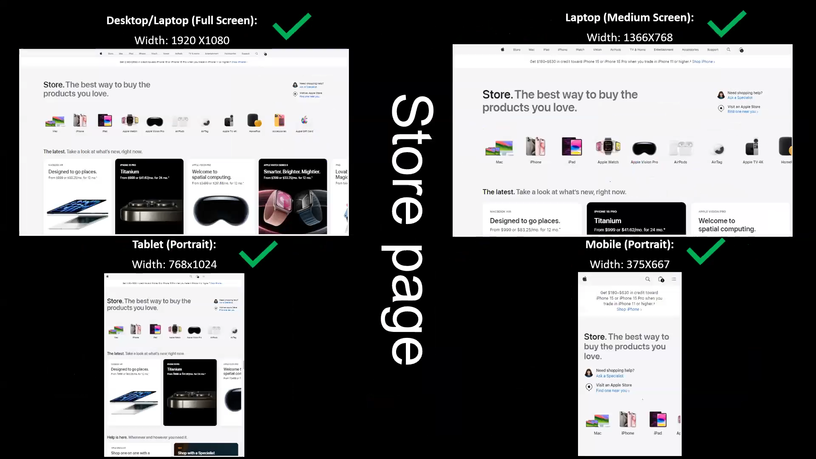
Store PAge

Slide 18
Common Website mistakes to avoid
Poor Navigation: Ensure your website is easy to navigate. Users should be able to find what they need quickly without getting lost.
Slow Load Times: Websites that take too long to load can frustrate users and lead to higher bounce rates. Optimize images and use efficient coding practices to improve speed
Lack of Mobile Responsiveness: With the increasing use of mobile devices, it’s crucial that your website looks and functions well on all screen sizes.
Cluttered Design: Avoid overcrowding your pages with too much content or too many elements. A clean, organized layout helps users focus on the important information
Unclear Calls to Action (CTAs): Make sure your CTAs are clear and compelling. Users should know exactly what action to take next.

Slide 19
Click Here to Direct Landing Page
https://gokulakrishnan-iph16pro-sites.my.canva.site/iph16pro

Slide 20
Thankyou

